Slide 1

UNIVERSITY INSTITUTE OF ENGINEERING
COMPUTER SCIENCE ENGINEERING
Bachelor of Engineering (Computer Science & Engineering)
Subject Name: Big Data Analytics
Subject Code: 20CST-471
Case studies on real-world Big Data applications.
Mapped with CO2
Prepared By:
Er. Ankita Sharma
DISCOVER . LEARN . EMPOWER

Slide 2
Case studies on real-world Big Data applications.
1. Google's PageRank Algorithm:
Industry: Search Engine
Challenge: Improve the relevance of search results.
Solution: Google's PageRank algorithm, based on big data principles, analyzes the link structure of the web to determine the importance of webpages. This approach significantly enhanced the accuracy and relevance of search results, revolutionizing the search engine industry.

Slide 3
2. Netflix's Content Recommendation System:
Industry: Media and Entertainment
Challenge: Personalize content recommendations for users.
Solution: Netflix employs big data analytics to analyze user viewing history, preferences, and behaviors. The recommendation system uses machine learning algorithms to suggest content, leading to increased user engagement and retention.

Slide 4
3. Walmart's Supply Chain Optimization:
Industry: Retail
Challenge: Optimize inventory management and reduce supply chain costs.
Solution: Walmart uses big data analytics to analyze sales patterns, weather conditions, and other factors to optimize inventory levels and distribution. This has led to significant cost savings and improved overall efficiency in the supply chain.

Slide 5
4. Uber's Dynamic Pricing:
Industry: Transportation and Logistics
Challenge: Optimize pricing during peak demand periods.
Solution: Uber employs big data to analyze real-time demand, traffic conditions, and other variables to implement dynamic pricing. This data-driven approach maximizes revenue during peak hours while balancing supply and demand.

Slide 6
5. Facebook's Social Graph Analysis:
Industry: Social Media
Challenge: Enhance user experience and engagement.
Solution: Facebook leverages big data analytics to analyze the social graph, understanding connections and interactions among users. This data is used to personalize content, improve targeted advertising, and optimize the overall user experience.

Slide 7
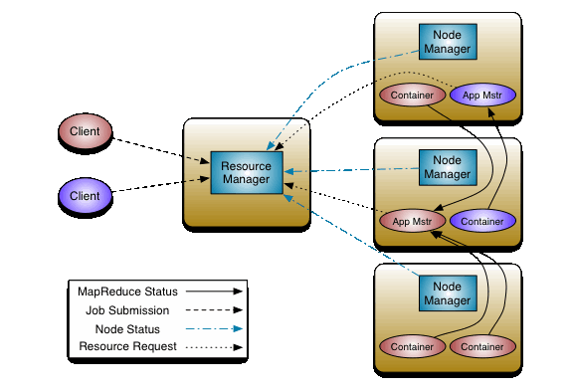

Slide 8
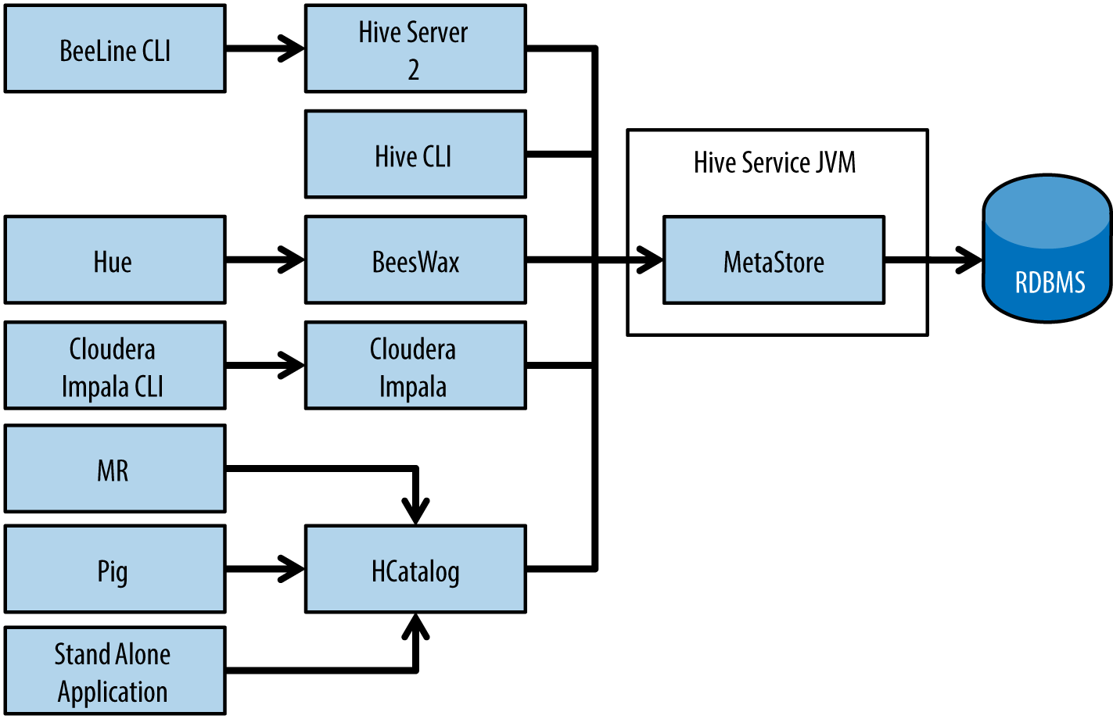

Slide 9
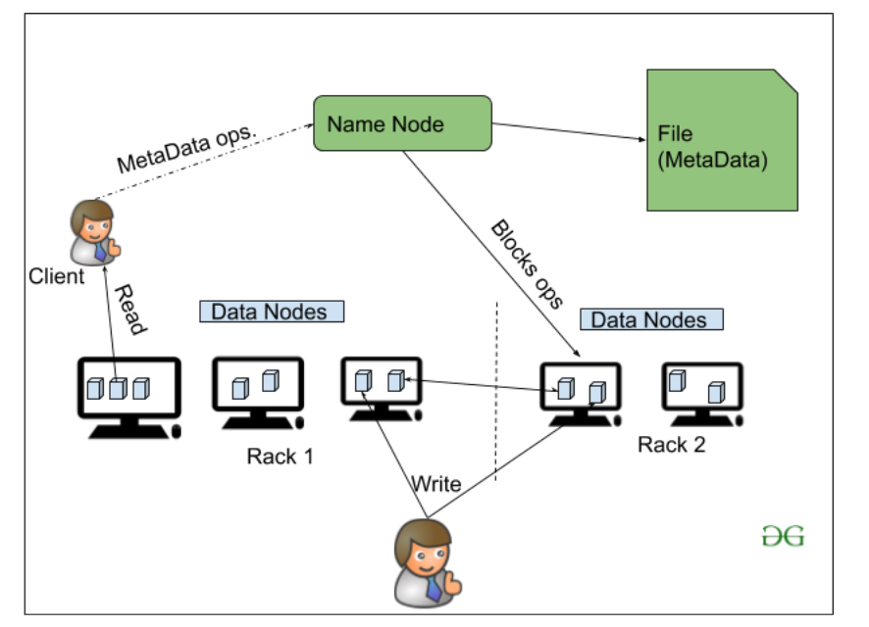

Slide 10
Thankyou

